Slide 1
Hostel World
By, Sameera Bellary

Slide 2
ABOUT HOSTELWORLD -
Hostel world is a leading global Online Travel Agent (OTA) focused on the hostel market with over 20 years experience.
They have hostels in Europe, Asia, North America, South America and Africa.
Operate in 179 countries.
There are private rooms which are pricier and shared rooms called dorms.
Mostly, the dorms are separate for females and males.
Some have mixed dorms i.e. male and female together.

Slide 3
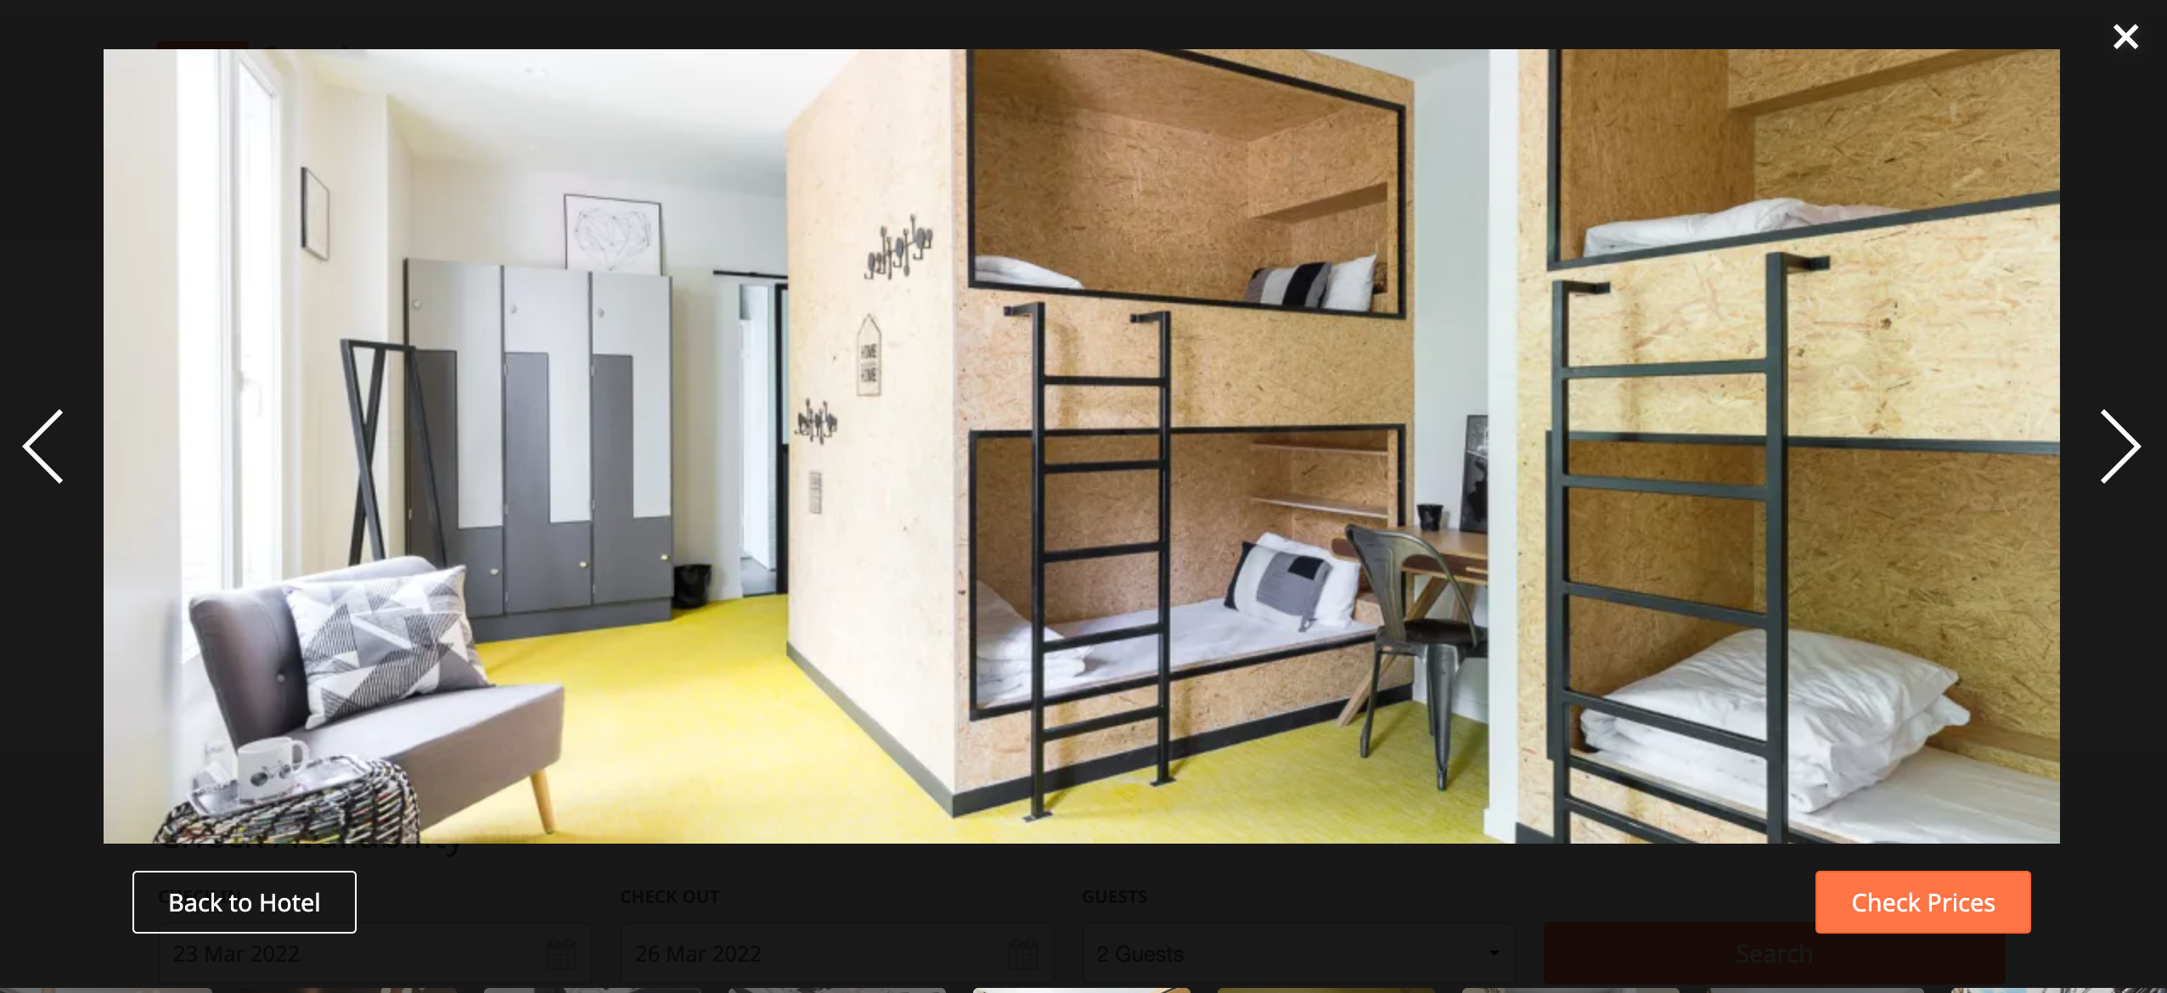
SHARED DORM ROOM

Slide 4
PROJECT GOAL -
Identify the features that affect the Overall Rating using Linear Regression to guide future business owners in the hostel industry.

Slide 5
CONSUMER STAR REVIEWS ARE NOTORIOUSLY BIASED !!
DO YOU AGREE ?

Slide 6
YES, BUT RATINGS AND REVIEWS STILL MATTER A LOT.
Research shows that 93% of customers check the reviews by previous customers before making a decision.
Positive or Negative reviews can significantly impact the sales.

Slide 7
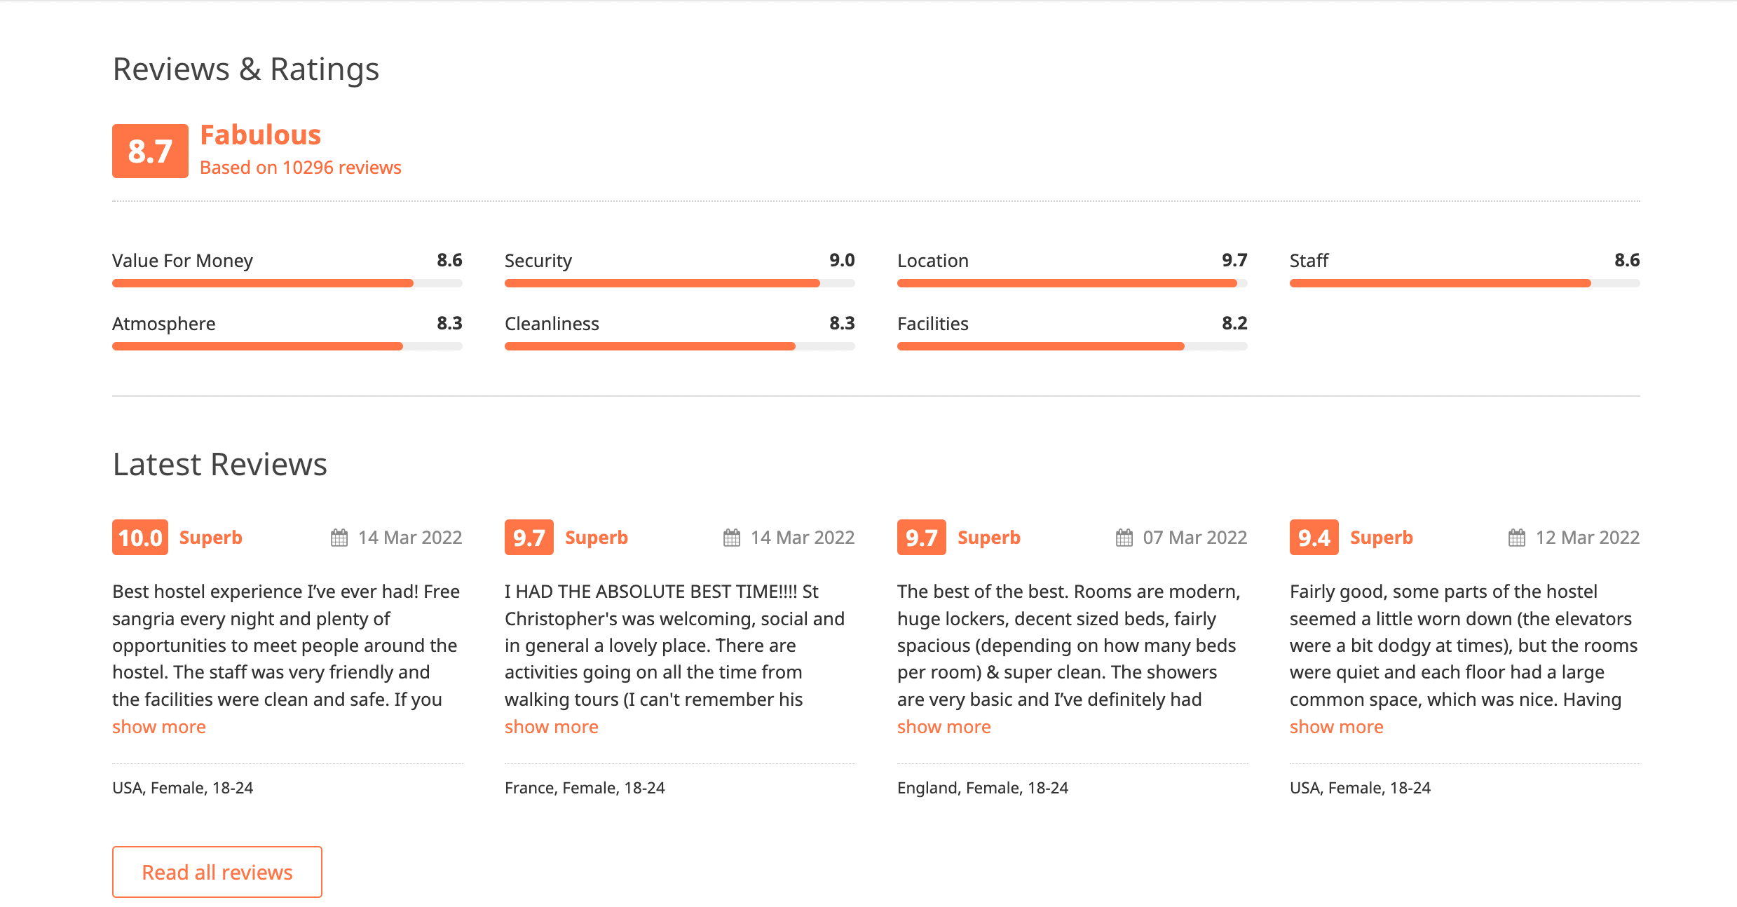
www.hostelworld.com has around 13 million reviews with more than 17,000 hostels all over the world.
TARGET

Slide 8
DATA COLLECTION AND CLEANING -
TOOLS – Selenium and BeautifulSoup
TOTAL NUMBER OF ROWS COLLECTED – 1665
AFTER DROPPING ROWS WITH NULL VALUES AND ZEROES – 1082

Slide 9
FEATURES – ALL ARE CATEGORICAL VARIABLES
Hostel name
Free breakfast
Free WIFI
Linen included
Lockers
Airconditioning
Common room
Laundry facilities
Fridge freezer
Microwave
Hot showers
Restaurant
Bar
Meals available
Cafe
Vending machines
Starting prices
Only Continuous Variable
24hoursecurity
24hourreception

Slide 10
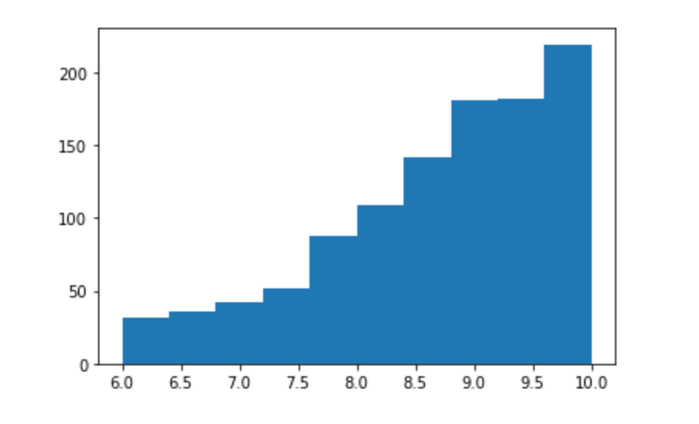
Distribution of the target variable – Overall Rating

Slide 11
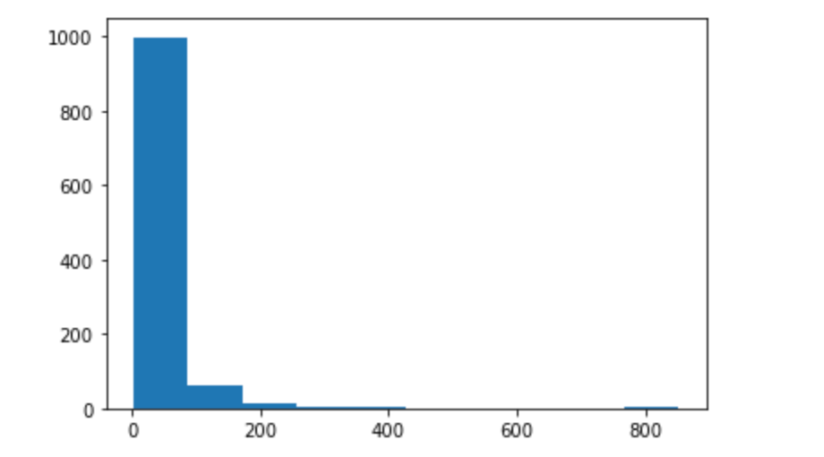
Distribution of the continuous variable – starting prices (USD)

Slide 12
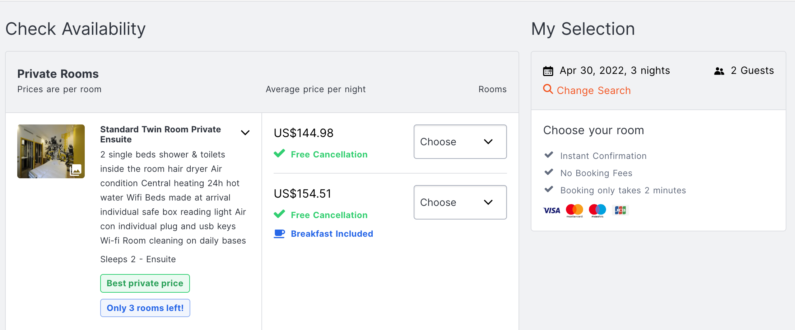
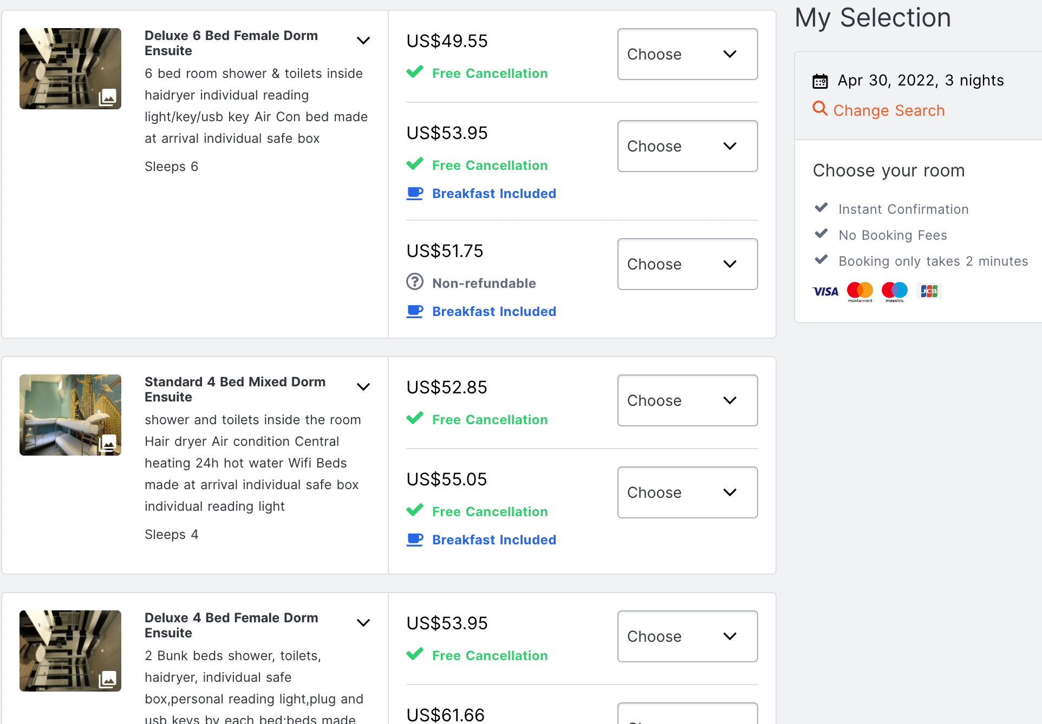
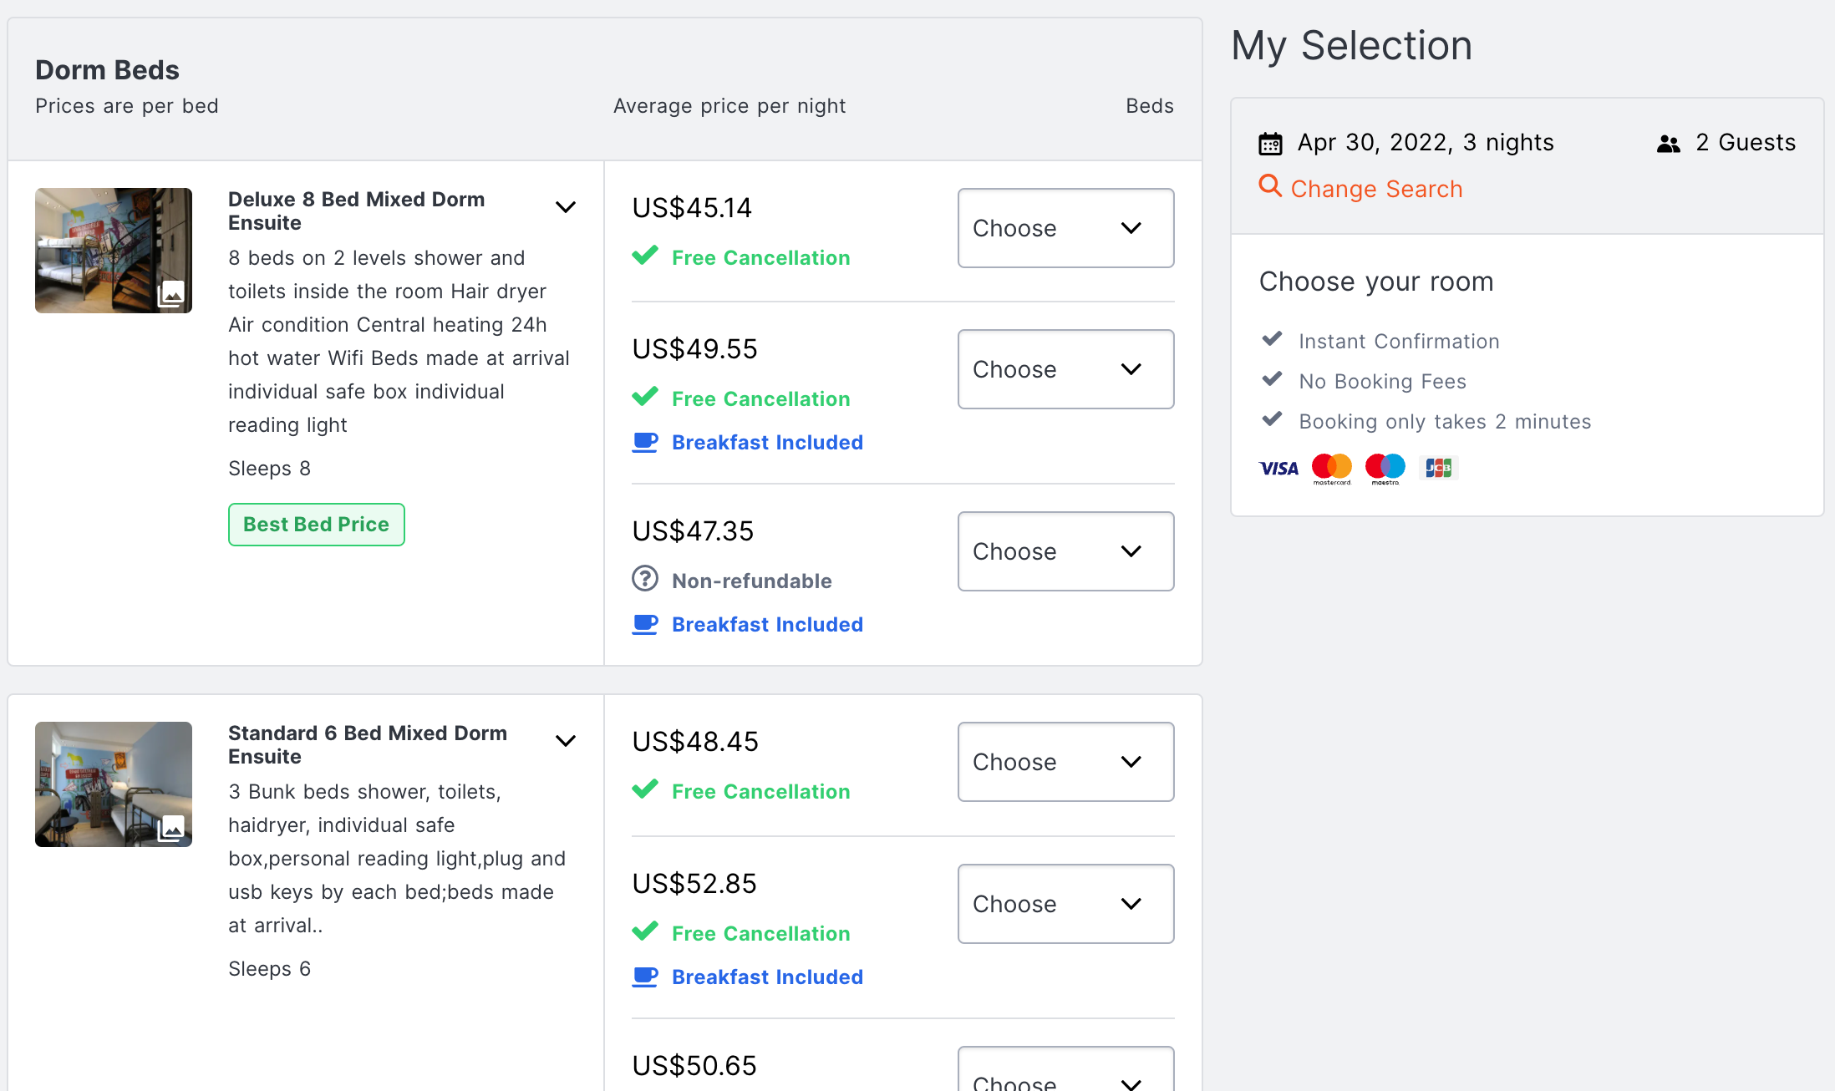
DIFFERENT RENT PRICES -

Slide 13
SPLIT THE DATA USING TRAIN_TEST_SPLIT FUNCTION -
Train + Validate Data = 80 % (60%+20%)
Test Data = 20 %

Slide 14
CROSS VALIDATION TESTING -
Use LassoCV on train data
Divide data 5 times
CV = 5
More Feature Engineering
Take log of a variable
Square a variable

Slide 15
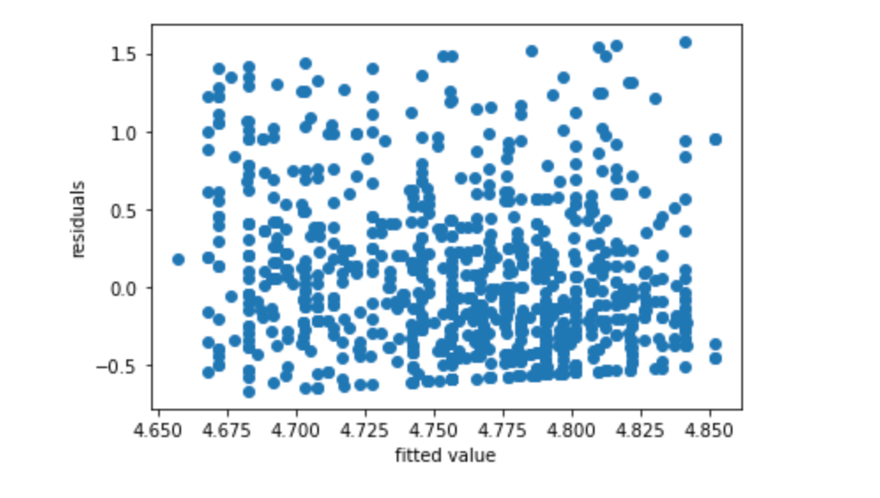
FINAL MODEL PERFORMANCE -
Since R^2<0.4, I would consider MAE and RMSE.
MAE = 0.4
RMSE = 0.5

Slide 16
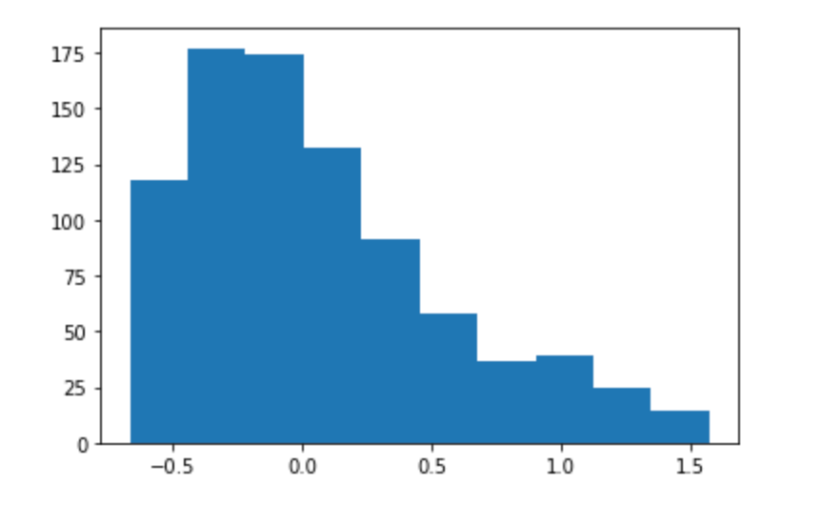
DISTRIBUTION OF RESIDUALS

Slide 17
FINAL VALUE OF THE TARGET VARIABLE -
AVERAGE PREDICTED RATING -
8.86
AVERAGE ACTUAL RATING -
8.73

Slide 18
FUTURE WORK
Include more features below listed -
Location from city center
Specify hostel has private rooms only/ dorms only / or both
Specify if there is a separate dorm for females only or has a mixed dorm
Specify the average of all the different rent prices for dorms and privates
Specify awards gained
Explore reviews and identify the key words which increase the rating using NLP

